Slide 1





Bachelor of Science (Honours) in
Banking and Finance
Validated by Queen Margaret University

Slide 2


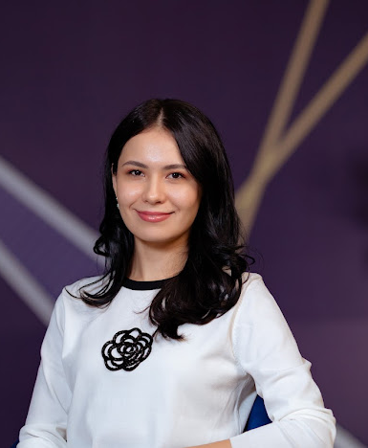
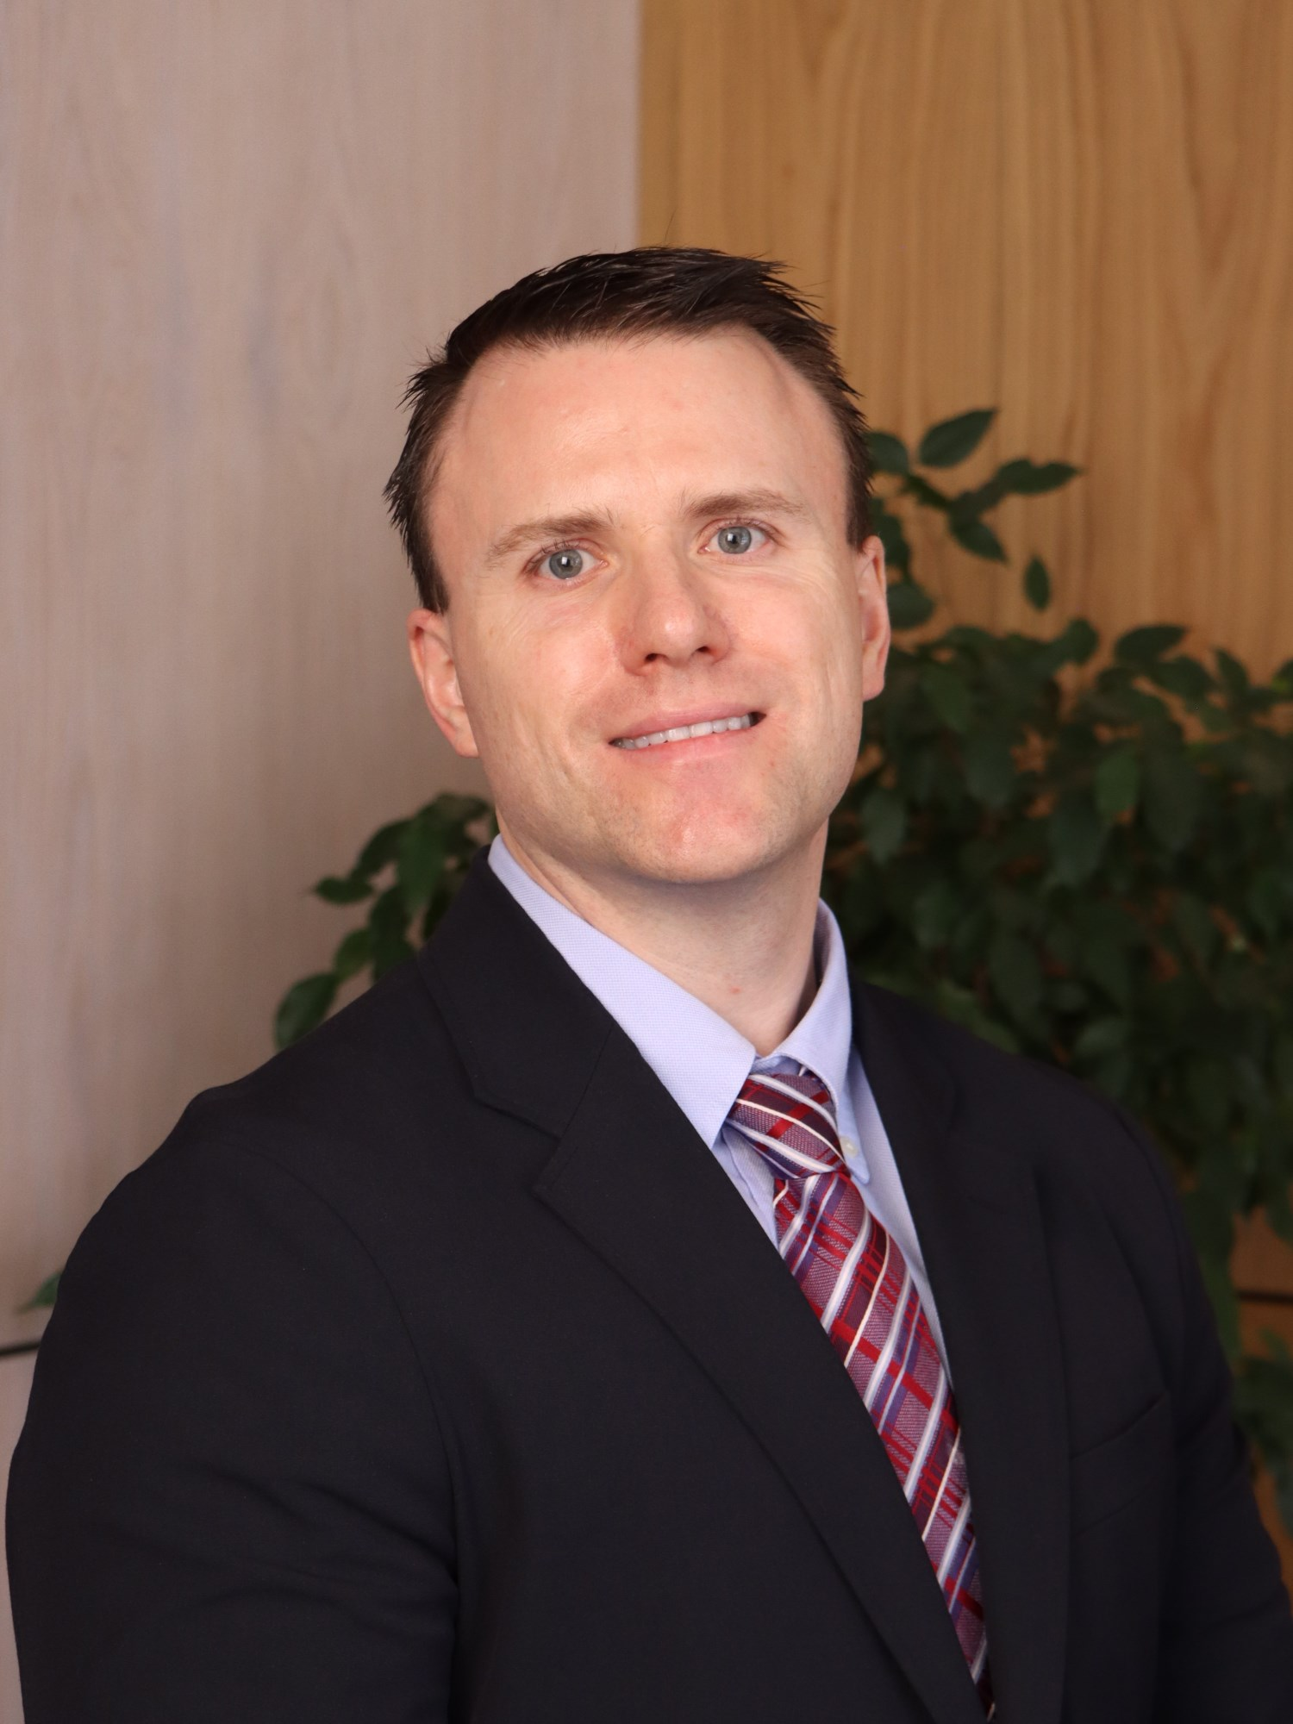
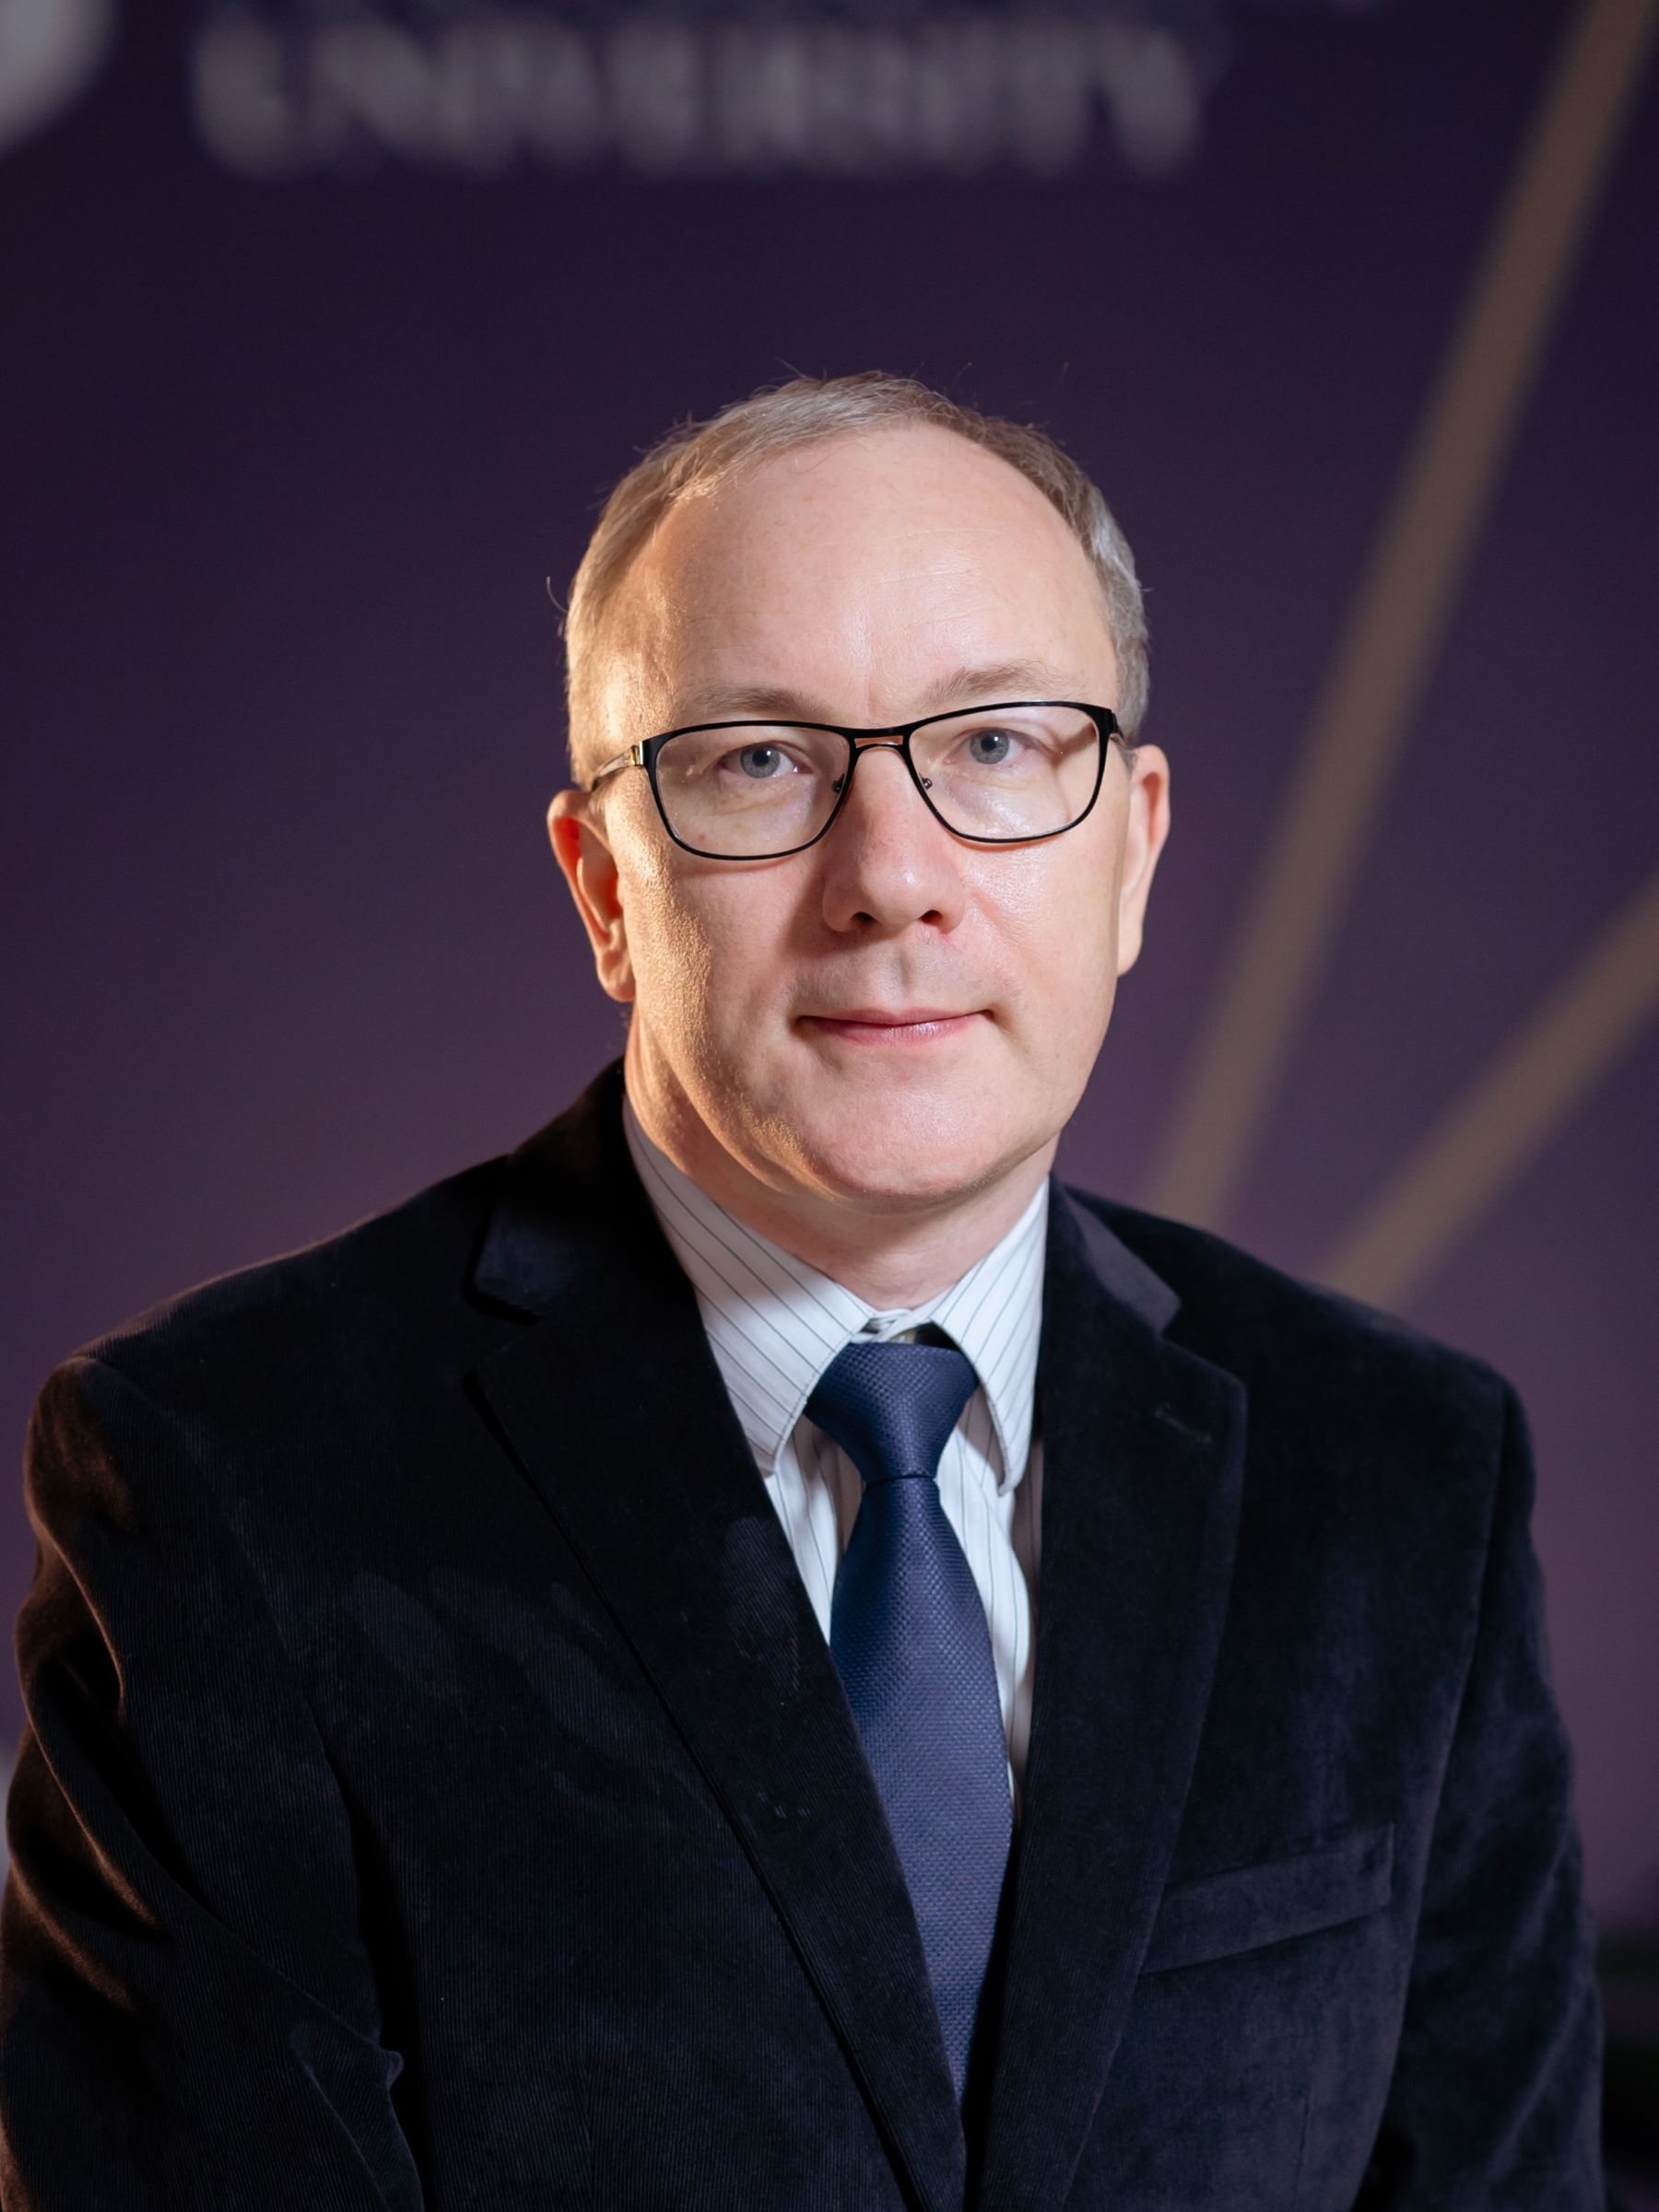

Academic Team – Banking and Finance
Iroda Mamashokirova, MSc, Leader of Banking and Finance Programme, Lecturer in Finance
i.mamashokirova@bmu-edu.uz
Lionel Henderson, DBA, Vice-Rector, Postgraduate Programmes and Internationalisation, Professor of Finance and Accounting l.henderson@bmu-edu.uz
Daniil Osipov, Ph.D, Associate Professor of Finance
d.osipov@bmu-edu.uz

Slide 3
Table of Content
Programme Objectives
Available Modules
Partner University
Professional Opportunities
Student Success Stories
Q&A Session

Slide 4
B&F Programme Objectives
Build Strong Foundations: Develop essential knowledge in financial theory, banking practices, and accounting principles.
Practical Financial Analysis: Equip students with the skills to analyze financial statements, investment opportunities, and risks effectively.
Strategic Financial Planning: Enable students to assess financial institutions' performance and design impactful financial strategies.
Global Financial Awareness: Foster an understanding of global financial markets and their operations.
Career Readiness: Prepare students for diverse career paths in finance, banking, investment, risk management, and consulting.

Slide 5
Available Modules
Year 1 (Semester 1) | Year 2 (Semester 1)
Principles of Microeconomics | Corporate and Business Law
Introduction to Accounting | Business Communication
Introduction to Finance | Management Accounting
Elective (General Education) | Business Information Systems
Year 1 (Semester 2) | Year 2 (Semester 2)
Principles of Macroeconomics | Banks and Other Financial Intermediaries
Business and Technology | Financial Management
Financial Accounting | Elective (from other programmes)
Introduction to Financial Markets and Institutions | Business Ethics and Professional Standards
Notes:
Electives (Y1): Globalisation, English Literature, Introduction to Philosophy, Career and Personal Development, Introduction to Programming with Python.
Electives (Y2): Data Analysis with Advanced Excel, Human Resource Management, Communication in Teams, Introduction to Communications and PR, Introduction to Sustainability

Slide 6
Available Modules
Year 3 (Semester 1) | Year 3 (Semester 2)
Valuation and Securities Analysis | International Financial Management and Banking
Derivatives and Financial Risk Management in Banking | Corporate Strategy
Elective (from other programmes) | Elective (from other programmes)
Capstone Project (Business Consultancy Project or Dissertation) Year Long
Notes:
Electives (Y3): Entrepreneurship, Foundations of Project Management, Data Visualization with Tableau, Banks and Other Financial Intermediaries, Global Business and Sustainability, Organisational Behaviour, Principles of Supply Chain Management, Environmental Economics

Slide 7
Your Academic Journey
Year 1: Core Foundations
Learn accounting, economics, and finance basics.
Build skills in financial analysis and economic reasoning.
Year 2: Intermediate Expertise
Master banking operations, financial markets, business law, and management.
Use advanced tools to solve financial problems.
Year 3: Advanced Leadership
Dive into derivatives, portfolio management, and international financial management.
Solve complex challenges with data-driven financial strategies.
“From Student to Finance Leader in Three Years!”

Slide 8

Our Partner University
Established: 1875, 150 years of educational history.
QS World Rankings: Placed in the top 50% of European institutions.
Core Values: Emphasizes intellectual curiosity, ambition, inclusiveness, and a commitment to societal well-being.

Slide 9
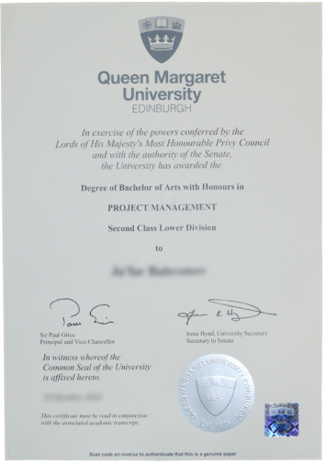
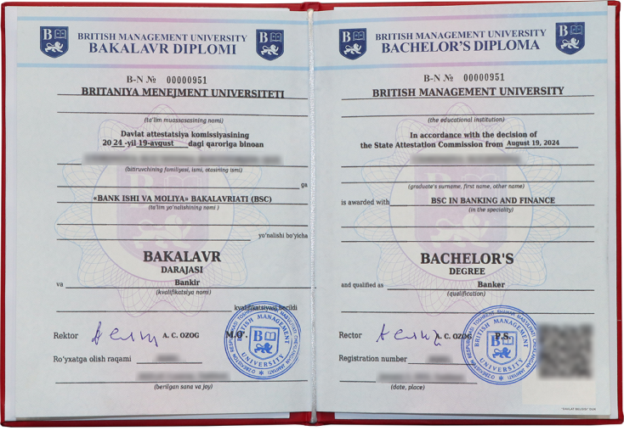
Dual Diploma

Slide 10
Careers
• Universal Applicability: Banking and Finance skills fit diverse roles:
- Financial Analyst
- Equity Researcher
- Portfolio Manager
- Risk Analyst
- Credit Manager
- Banker and other related finance jobs.
• Career Flexibility: Pivot across sectors with a strong financial foundation.
• Real Impact: Drive decisions in startups, banks, or global firms.
“One Degree, Endless Possibilities!”

Slide 11
Demand for Banking and Finance Experts
Financial careers range from investment banking to financial planning, with most high-level positions offering six-figure earning potential.
Most roles require a bachelor's degree in a relevant field, while professional certifications like chartered financial advisor (CFA)or actuarial credentials can significantly boost career prospects.
“One Degree, Endless Possibilities!”

Slide 12
Join to Our Success Stories
Statistics:
• 70% of students are employed within 3 months.
• 90% in top banks, consultancies, and private companies.
“Be Our Next Success Story!”

Slide 13
Top Industries Graduates are Working

Slide 14
































Slide 15
Why Study Banking and Finance Programme?
• Career-Focused: Build skills for high-demand roles in international banking and finance.
• Globally Recognised: Dual degrees from BMU and Queen Margaret University.
• Professional Certification Alignment: Incorporates content from the Chartered Financial Analyst (CFA) Level 1 syllabus.
• Practical Learning: Blend theory with real-world data to solve financial challenges.
• Future-Ready: Master financial trends and strategies.
“Your Skills, Your Global Impact!”

Slide 16
Let’s Shape Your Future
Summary:
• World-class education with dual degrees.
• Skills for high-demand careers.
• Proven success with thriving alumni.
“Your Future in Finance Awaits!”

Slide 17
Your Questions, Our Answers
What excites you about banking and finance?
“Let’s Talk About Your Future!”

Slide 18

Bachelor of Science (Honours) in
Accounting and Finance
Accredited by ACCA (Association of Chartered Certified Accountants)
Notes:
Association of Chartered Certified Accountants

Slide 19
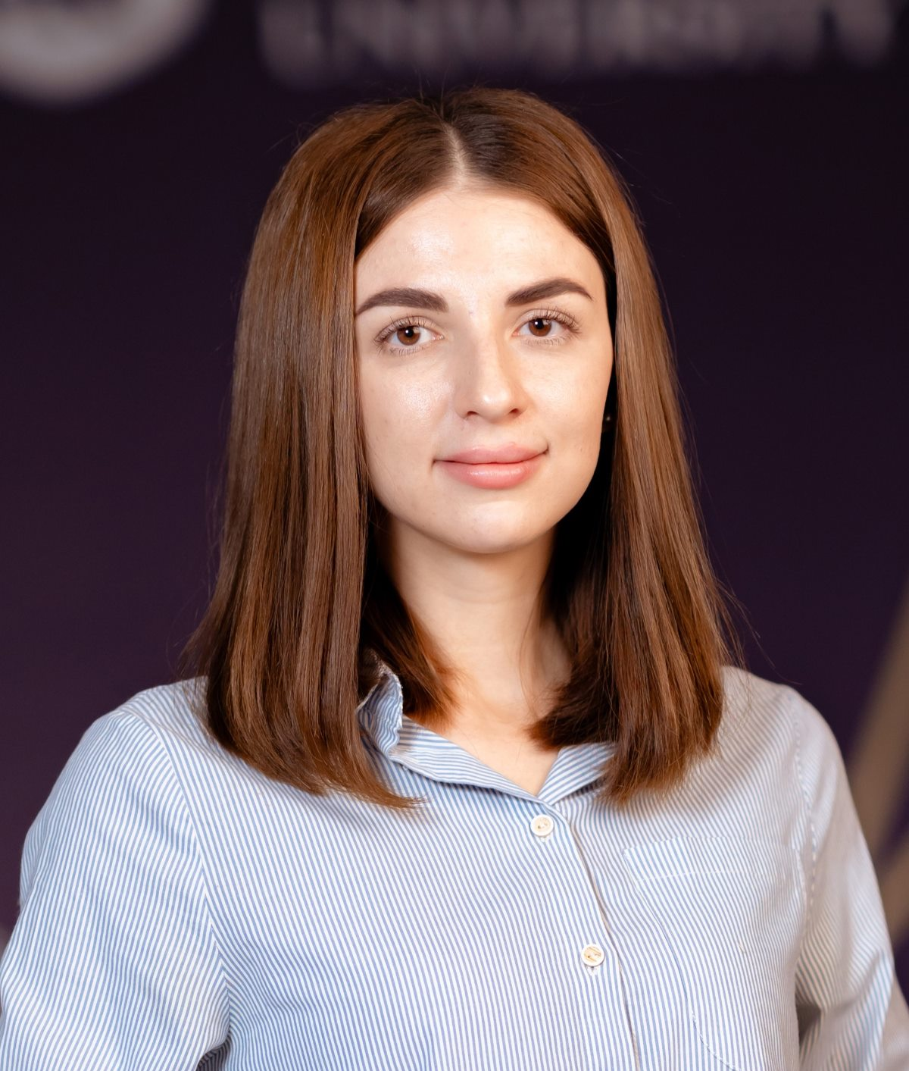
Table of Content
Programme Objectives
Knowledge and Skills
Programme Structure
Dual Diploma
ACCA Qualification
Job Opportunities: local and global
Q&A Session
Natalya Fedoryak -
Leader of Accounting and Finance Programme

Slide 20
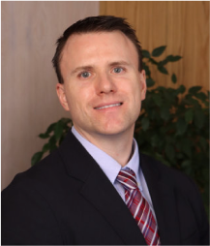

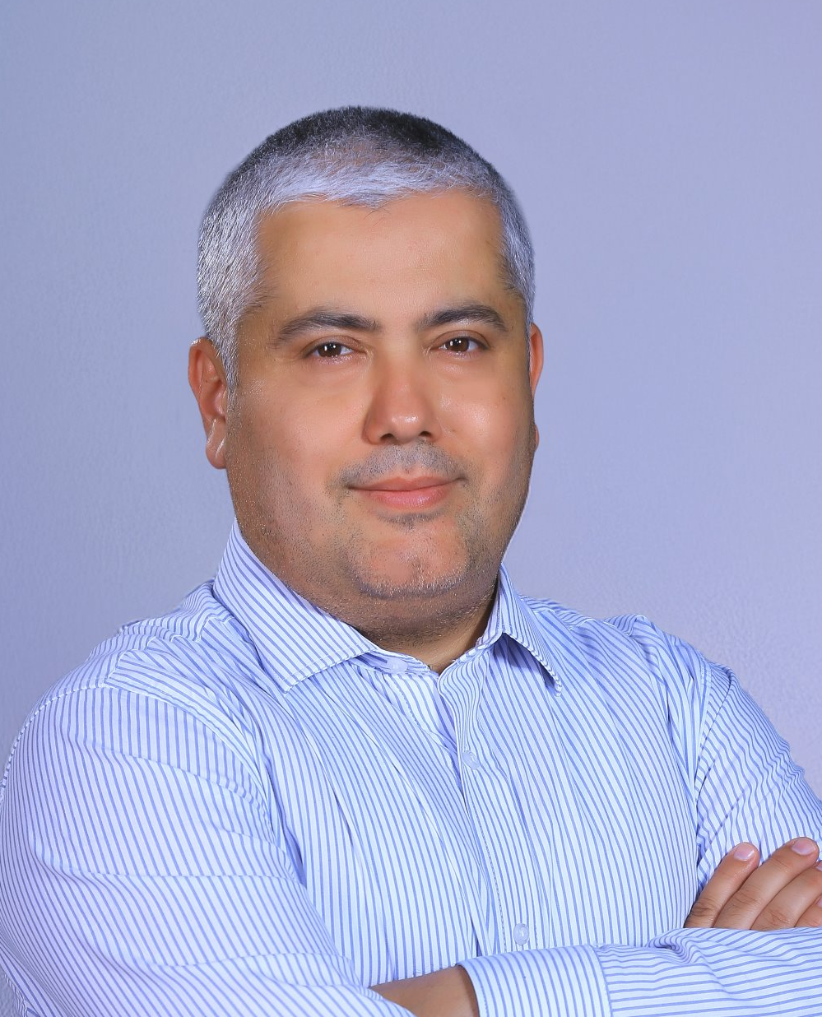
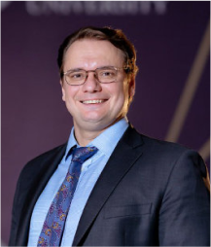


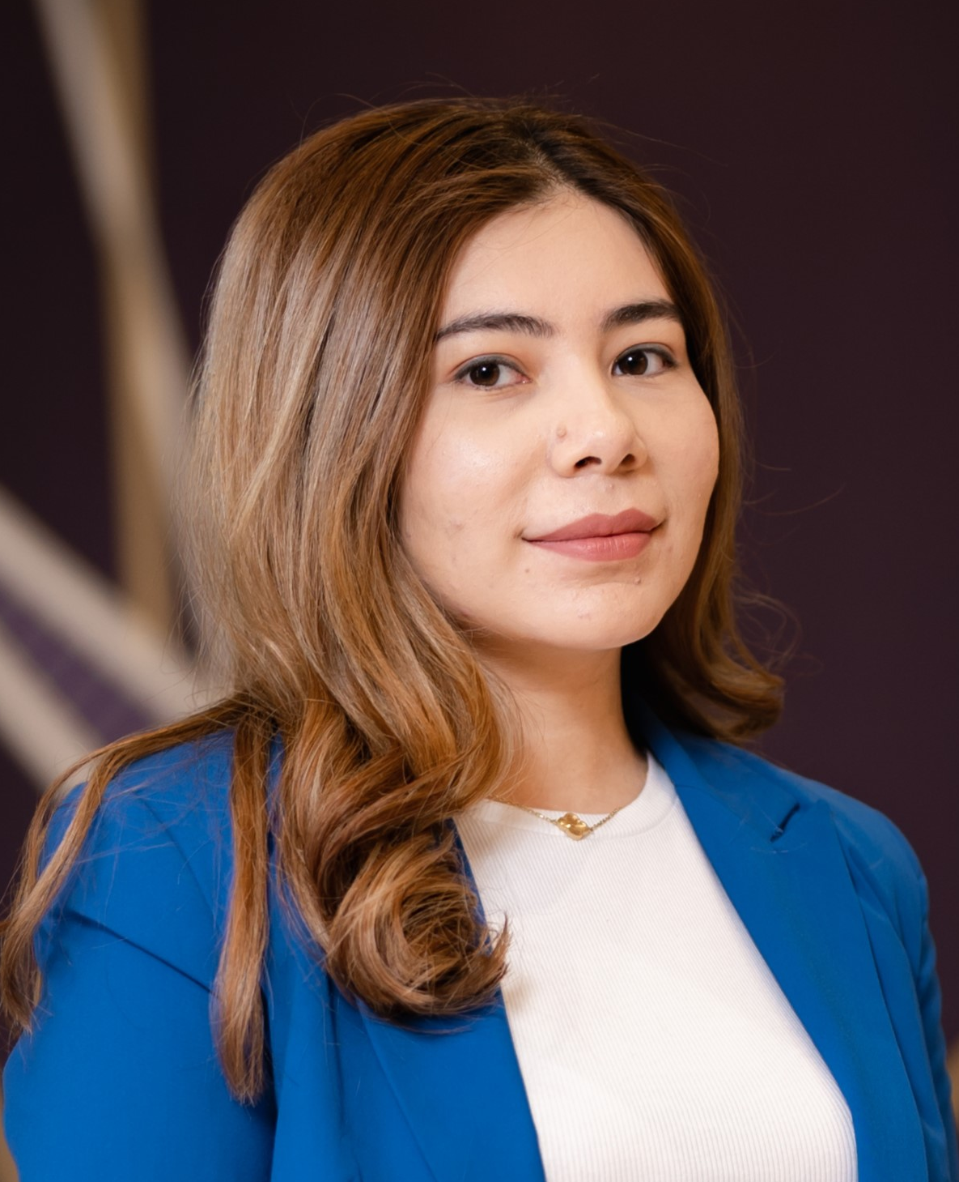
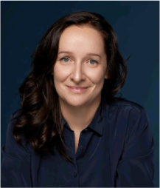
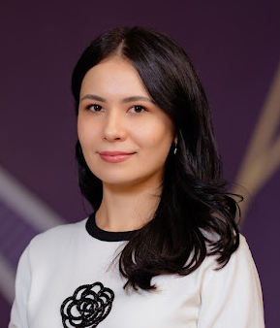
Faculty Members
Yuri Loktionov, Ph.D., CFA Professor of Finance and Accounting, Rector
Lionel Huntley Henderson, DBA, Professor of Finance and Accounting
Daniil Osipov, Ph.D. Associate Professor of Finance
Abdurasul Abdurakhmanov, Ph.D., Lecturer in Economics
Natalya Muzafarova, Dean of UG Studies
Natalya Fedoryak, MSc,
ACCA, Lecturer in Financial Accounting
Iroda Mamashakirova, MSc, Lecturer in Finance
Markhabo Nazarova, MSc, Lecturer in Business Law

Slide 21
A&F Programme Objectives
Provide strong theoretical grounding in accounting and finance, with practical application
Develop employability and transferable skills for careers in financial analysis, accounting, auditing, and investment management
Foster critical thinking on ethical and social impacts of financial decisions
Support academic and personal growth for career readiness and lifelong learning

Slide 22
Core Knowledge and Skills
Accounting Principles and Standards:
Financial and Management accounting
IFRS (International Financial Reporting Standards)
Preparation and analysis of the financial statements
Finance Fundamentals:
Corporate finance, capital structure, and security valuation
Investment appraisal and portfolio management
Financial markets, institutions, and instruments

Slide 23
Contextual Knowledge and Skills
Regulatory & Ethical Frameworks:
Business law, tax regulations, and auditing standards
Ethical implications in financial decision-making
Corporate governance and compliance
Economics & Business Context:
Micro and macroeconomic principles
Global business environments and sustainability
Risk management and strategic decision-making

Slide 24
A&F Programme Structure
Year 1 (Semester 1) | Year 2 (Semester 1)
Principles of Microeconomics | Corporate and Business Law (LW)
Introduction to Accounting | Business Communication
Introduction to Finance | Management Accounting (MA)
Elective (General Education) | Business Information Systems
Year 1 (Semester 2) | Year 2 (Semester 2)
Principles of Macroeconomics | Financial Reporting (FR)
Business and Technology (BA) | Financial Management (FM)
Financial Accounting (FA) | Elective (from other programmes)
Introduction to Financial Markets and Institutions | Business Ethics and Professional Standards
Notes:
Electives (Y1): Globalisation, English Literature, Introduction to Philosophy, Career and Personal Development, Introduction to Programming with Python.
Electives (Y2): Data Analysis with Advanced Excel, Human Resource Management, Communication in Teams, Introduction to Communications and PR, Introduction to Sustainability

Slide 25
A&F Programme Structure
Year 3 (Semester 1) | Year 3 (Semester 2)
Audit and Assurance (AA) | Strategic Management Accounting (PM)
International Taxation (TX) | Corporate Strategy
Elective (from other programmes) | Elective (from other programmes)
Capstone Project (Business Consultancy Project or Dissertation) Year Long
Notes:
Electives (Y3): Entrepreneurship, Foundations of Project Management, Data Visualization with Tableau, Banks and Other Financial Intermediaries, Global Business and Sustainability, Organisational Behaviour, Principles of Supply Chain Management, Environmental Economics

Slide 26
Dual Diploma

Slide 27
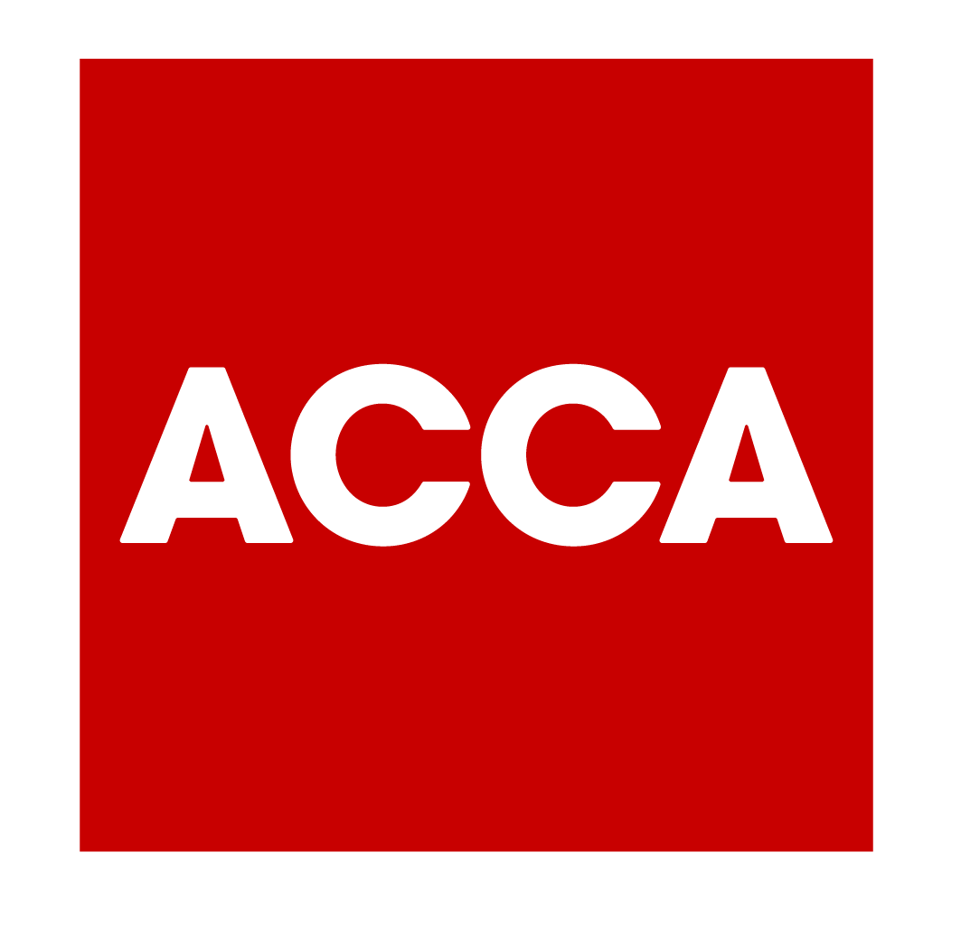
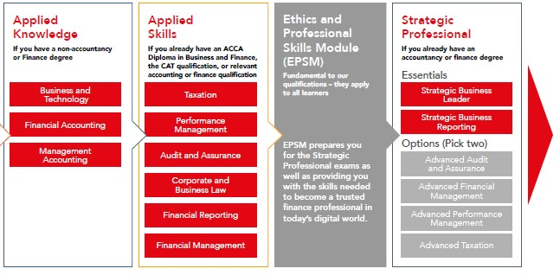
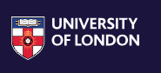
A&F Programme and ACCA Qualification
Advanced Diploma in
Accounting and Business
ACCA Member
Students are awarded with the ACCA Advanced Diploma in Accounting and Business after PASSING TWO EXAMS + ETHICS MODULE:
Financial Reporting
Financial Management
Ethics and Professional Skills Online Module
The University of London recognizes ACCA exams as credit towards the MSc in Professional Accountancy.
Notes:
ACCA members and affiliates ONLY need to complete TWO modules and a compulsory Capstone project module to get their MSc in Professional Accountancy. Founded in 1836, the University of London is one of the oldest and most prestigious in the UK – and it has a long history of making its degrees accessible to students all over the world. Their past students include SEVEN Nobel Prize winners, including Nelson Mandela. University of London has more than 50,000 students in 180 countries. So no need to relocate as you can study where you live.

Slide 28
A&F Programme and ACCA Qualification
The university provides students with the following services and covers the related payments.
Service provided:
Payments covered:
Registration to the ACCA qualification
Exemptions for 7 ACCA exams (upon successful graduation from the BSc in Accounting & Finance)
Registration for 2 ACCA exams
  (Financial Reporting and Financial Management)
Registration for Ethics and Professional Skills Online Module
ACCA Registration Fee
ACCA Subscription Fee
Exemption fees for 7 ACCA exam
Registration fees for 2 ACCA exams
  (Financial Reporting and Financial Management)

Slide 29
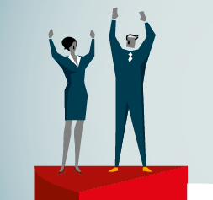
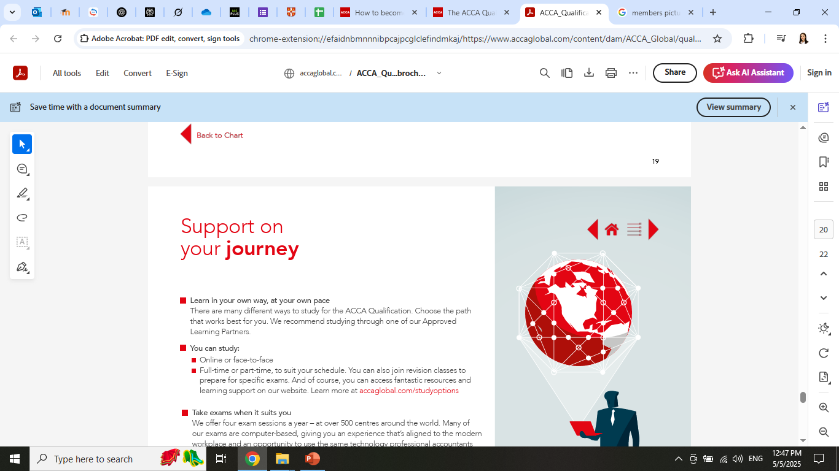

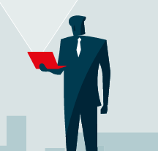
ACCA Qualification
The Association of Chartered Certified Accountants (ACCA) is a globally recognized professional qualification in accounting and finance.
ACCA is the world’s largest accountancy body and globally connected community with:
247,000 members and 526,000 students
in 181 countries
121 years of existence
7,959 approved employers

Slide 30
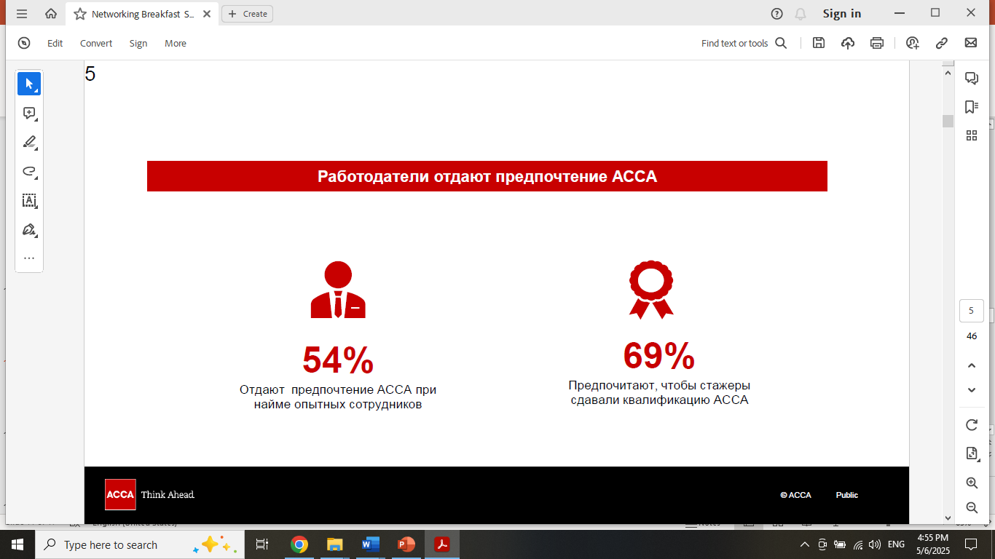
Local Demand for ACCA Qualification
High demand for IFRS-certified accountants in Uzbekistan:
Government mandates transition to IFRS starting from 2021 to all large companies, banks, insurance firms, and government-owned companies
Each of the above-mentioned organisations must have at least 3 IFRS-certified accountants in each
Over 7,000+ companies affected, creating overall demand for 21,000+ IFRS-certified accountants
Notes:
Statistics for 2025:
Large Companies 4,684
Commercial Banks 33
Insurance Companies 35
State-Owned Enterprises ~2,541

Slide 31


Graduates Employability 2024
10 graduates
Accountants
Audit Assistants
Auditors
4 graduates
Audit Assistants
Accountants
2 graduates
Auditors
1 graduate
Tax and Legal
Other Industries
Ministry of Investments and Foreign Trade (2 graduates)
Ministry of Finance and Economy (2 graduates)
Ipak Yuli Bank (4 graduates)
Garant Bank (2 graduates)
TBC Bank (1 graduate)
British Council (2 graduates)

Slide 32
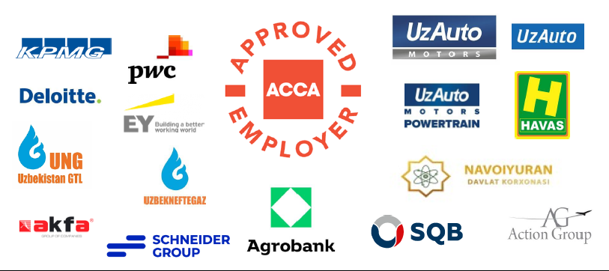
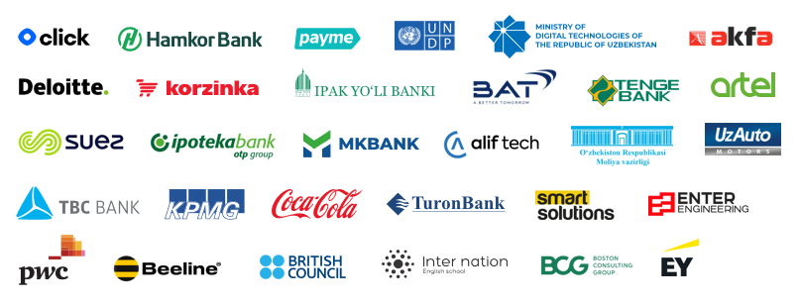
ACCA-accredited employers in Uzbekistan
Key Partners
Notes:
Companies or organizations based in Uzbekistan that have been officially approved by the ACCA as meeting specific standards for supporting ACCA students or members.
This accreditation means that the employer:
Provides high-quality training and professional development for employees pursuing the ACCA qualification
Offers relevant work experience that counts toward ACCA membership requirements
Is recognized by ACCA as a good environment for accounting and finance professionals
In short, working for an ACCA-accredited employer in Uzbekistan helps students and professionals progress more smoothly toward becoming fully qualified ACCA members.

Slide 33
Global Demand for ACCA Qualification
54% of employers prefer ACCA when hiring experienced professionals
69% of employers prefer interns to pursue the ACCA qualification
Relevant job positions:
Audit Senior
Financial Accountant
Management Accountant
Financial Analyst
Tax Manager
Financial Manager
Notes:
According to ACCA's global research

Slide 34
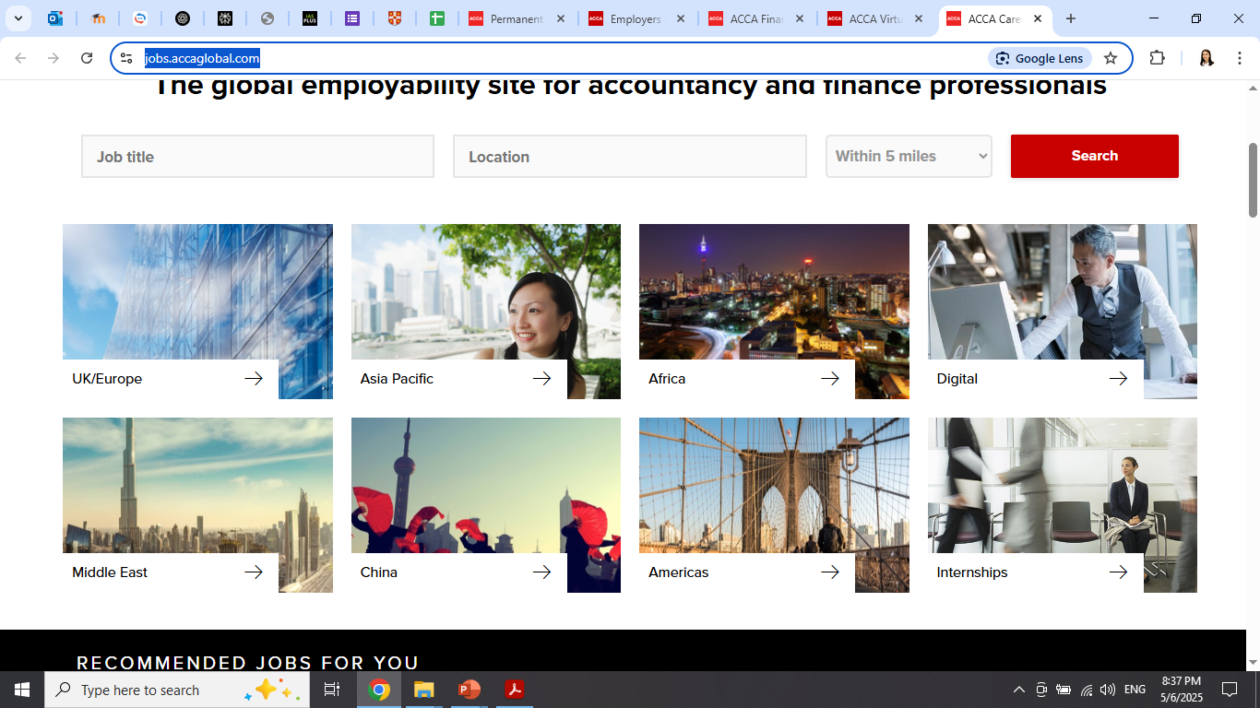
International Opportunities
The global employability site for accountancy and finance professionals (ACCA Careers)
ACCA Virtual Careers Fairs:
51 Careers Fairs since 2020
3,477 organisations involved
202,000+ participants registered
57,250+ unique job applications
Notes:
ACCA Careers one of the world’s leading employability sites for finance professionals.

Slide 35
Questions & Answers
Session

Slide 36
BSc in
Management Information Systems
with Business Analytics

Slide 37
Programme Objectives – MIS with Business Analytics
Deliver a rigorous and engaging curriculum in MIS, focused on Business Analytics for data-driven decision-making
Explore MIS, business processes, and data analytics through critical and analytical lenses
Train students to bridge the gap between tech experts and business leaders for effective communication
Equip graduates with skills to design innovative analytical solutions that drive strategy and performance
Offer a degree valued by employers seeking logical, data-savvy professionals
Build expertise in data management, visualization, predictive analytics, and machine learning for real business impact

Slide 38
What You’ll Learn: Knowledge and Understanding
Apply core management principles to design data-driven information systems
Use systems analysis, BI tools, and project management to improve business processes
Apply analytics, predictive modeling, and data visualization to strategic decisions
Understand IS management, data governance, cybersecurity, and sustainability
Specialize in business analytics to solve complex problems using data insights
Act as a translator between tech teams and business professionals
“From understanding to leadership in digital transformation.”

Slide 39
What You’ll Gain: Skills and Abilities
Analyze structured and unstructured data while following ethical/legal standards
Solve business problems using models, and communicate insights clearly
Build BI solutions with Python, SQL, Excel, and Power BI
Use IT tools to support data-driven decision-making
Apply statistics, forecasting, and optimization techniques in real cases
Lead and collaborate in interdisciplinary projects with confidence
Adapt to new technologies and commit to lifelong learning
Make responsible computing decisions grounded in ethics and law
Design and manage decision support systems in business contexts
“Data skills that work in the real world.”

Slide 40
Programme Structure –
Your Pathway to Expertise
24 compulsory modules totaling 480 UK credits across three academic years
Four core pillars:
  Finance & Accounting – Principles of accounting, finance, and quantitative methods
  Information Systems – Programming, databases, secure computing, and systems design
  Data Analytics & Visualization – Statistics, Excel, Power BI, Python, and ML for business
  Supporting Skills – Business communication, project management, and electives
Final-year capstone project (40 credits): choose between academic dissertation or consultancy project
“Balanced, practical, and designed for the real digital economy.”

Slide 41
Available Modules
Year 1 (Semester 1) | Year 2 (Semester 1)
Principles of Microeconomics | Data Visualization (Power BI)
Introduction to Accounting | Business Communication
Introduction to Finance | Fundamentals of PM
Intro to Programming with Python | Business Information Systems
Year 1 (Semester 2) | Year 2 (Semester 2)
Statistics for Business Analytics | Secure Computing
Data Analysis with Advanced Excel | Principles of Databases
Communication in Teams | Machine Learning for Business
Elective (from other programmes) | Elective (from other programmes)
Notes:
Electives (Y1): Globalisation, English Literature, Introduction to Philosophy, Career and Personal Development, Introduction to Programming with Python.
Electives (Y2): Data Analysis with Advanced Excel, Human Resource Management, Communication in Teams, Introduction to Communications and PR, Introduction to Sustainability

Slide 42
Available Modules
Year 3 (Semester 1) | Year 3 (Semester 2)
Advanced Databases | IS Management and Strategy
IS Ethics and Sustainability | Information Systems Analysis
Elective (from other programmes) | Elective (from other programmes)
Capstone Project (Business Consultancy Project or Dissertation) – Year Long
Notes:
Electives (Y3): Entrepreneurship, Foundations of Project Management, Data Visualization with Tableau, Banks and Other Financial Intermediaries, Global Business and Sustainability, Organisational Behaviour, Principles of Supply Chain Management, Environmental Economics

Slide 43
Your Academic Journey
Year 1: Core Foundations
Learn the basics of microeconomics, accounting, and finance
Start coding in Python and analyzing data in Excel
Build statistical thinking for business analytics
Strengthen communication and teamwork skills
Year 2: Tools and Technologies
Master data visualization using Power BI and business intelligence tools
Explore secure computing, databases, and machine learning applications
Apply project management principles in tech-driven environments
Develop insight into how information systems support modern businesses
Year 3: Strategic Impact
Focus on ethics, governance, and sustainability in information systems
Analyze organizations through IS strategy and system design
Solve real-world business challenges through a capstone consultancy project or dissertation
Customize your path with electives aligned to your career goals
“From code to strategy – your journey in MIS begins here.”

Slide 44
Careers
Progress to postgraduate degrees in MIS, Data Science, or Analytics
Pursue global certifications: PMP, Microsoft’s Power BI, Google Analytics, or Python
Career-ready for roles like:
    Business/Data Analyst
    Information Systems Manager
    BI Consultant
    IT Project Manager
Thrive in local startups or international tech firms
“You’re not just employable. You’re future-proof.”

Slide 45
Why MIS with Business Analytics @ BMU?
Study full-time in Tashkent with a UK-style degree
English-taught curriculum aligned with international standards (IEEE, ACM and CSAB)
Capstone projects solve real industry problems
Emphasis on ethical tech and sustainable systems
Diverse electives and cross-discipline flexibility
“Global quality. Local opportunity.”

Slide 47
Got Questions? We’ve Got Insights.

Slide 48
BBA (Hons) with pathways
Validated by Queen Margaret University

Slide 49
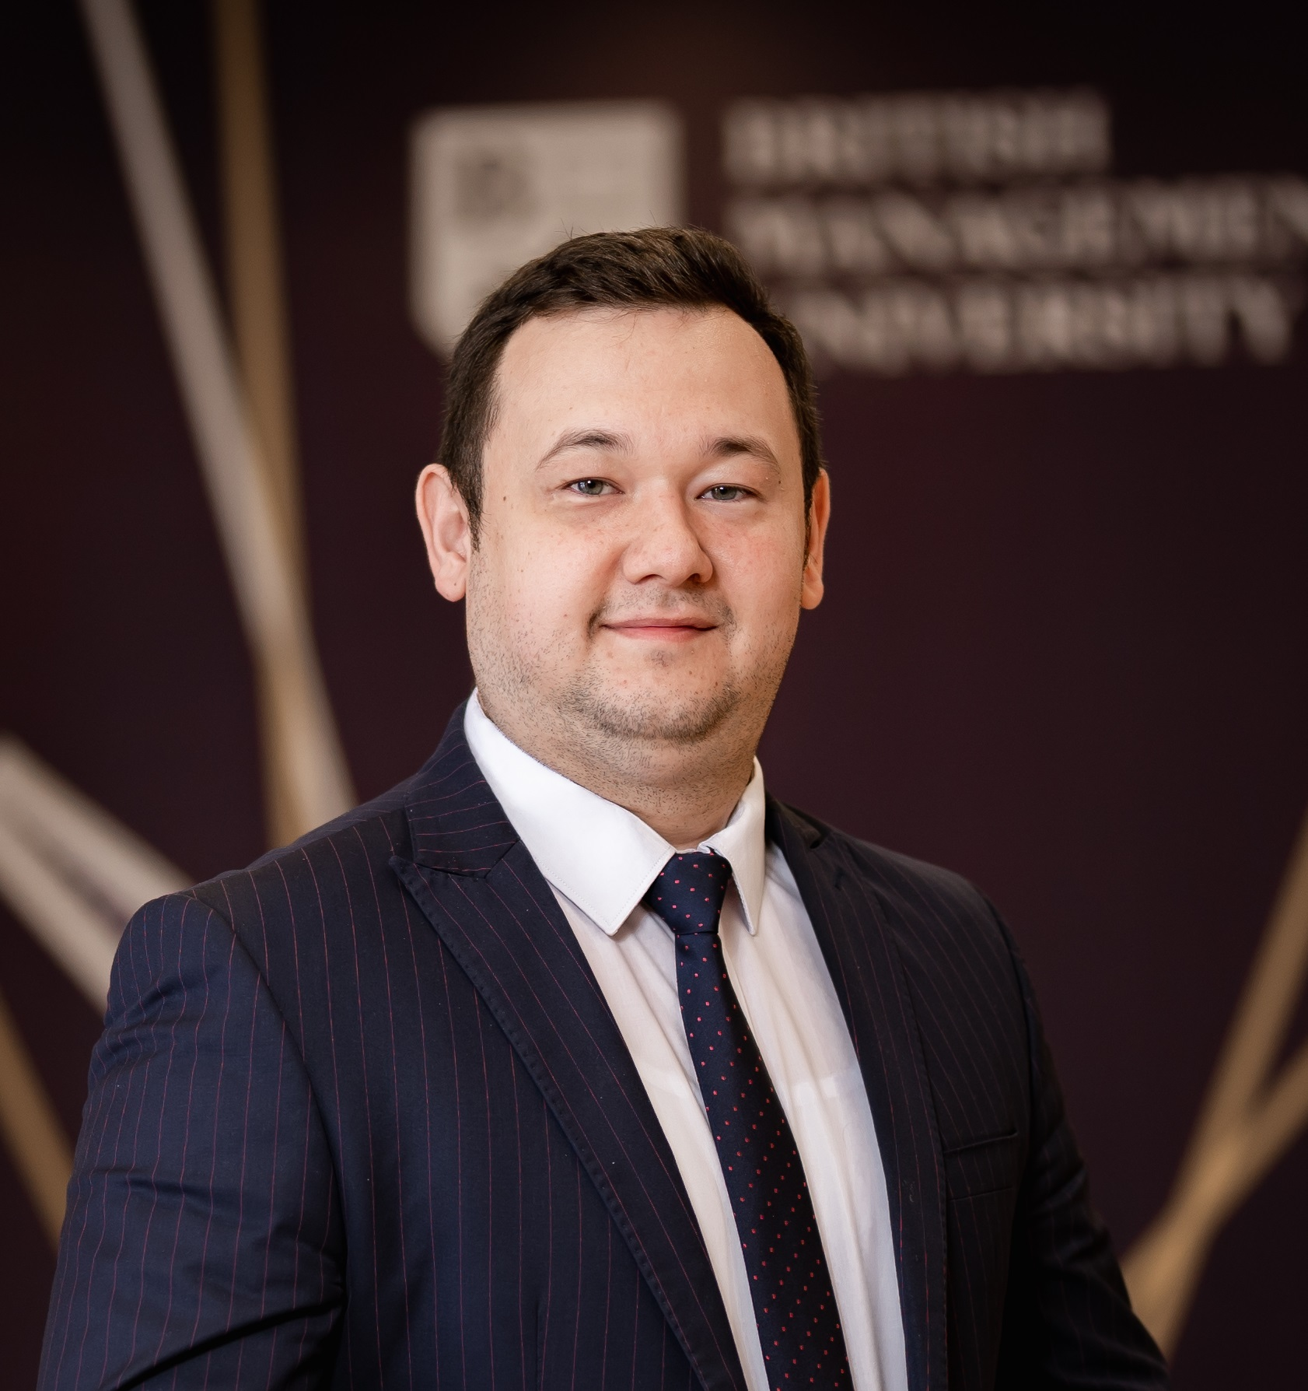
BBA with pathways Programme Overview
Business Administration with Project Management
Business Administration with Logistics and Supply Chain Management
Business Administration with E-Business and Digital Marketing
Business Administration with Communications and Public Relations
Sardor Pulatov – Program Leader ;
Module coordinator and Lecturer in Economics, Business and Management

Slide 50
BBA with pathways Programme – Key Takeaways
Project Management is the art and science of planning, organizing, and overseeing projects to finish them on time and on budget. A “project” can be anything with a clear goal and timeline – from building a new campus to launching a mobile app.
Digital marketing and e-business are about using the internet to do business and reach customers through online channels to promote products, services, or brands.
Logistics and Supply Chain Management is all about how goods and materials move from point A to point B – and eventually to the end consumer. It covers planning and overseeing the entire journey of a product: sourcing raw materials, manufacturing, transporting and warehousing, and distribution to stores or customers
PR (Public Relations) and Communication is about managing how organizations interact with the public and the media.

Slide 51
BBA with pathways Programme Objectives
To prepare graduates for administrative careers in the public, private or not-for-profit sector;
To develop graduates’ understanding of organisations (public, private, not-for-profit) in terms of purpose, operational structures and the manner in which external environments influence organisations and their management;
To enhance graduates’ general transferable and intellectual as well as subject specific knowledge and skills, including conceptual thinking, critical analysis, research and problem-solving, reasoned argument, selection and synthesis;
To cultivate students who can demonstrate the ability to act entrepreneurially, commercial acumen, numerical and communication skills within a comprehensive range of sizes and structures of organisations including small and medium enterprises;
To enable graduates to develop a wide range of “hard” and “soft” skills and attributes, such as the ability to work to deadlines, both individually and in teams, through self-reflection and self-management, develop effective interpersonal skills and a capacity for innovative approaches and adaptability while responding effectively to the professional demands of contemporary business administration; thus equipping graduates to become effective global citizens.

Slide 52
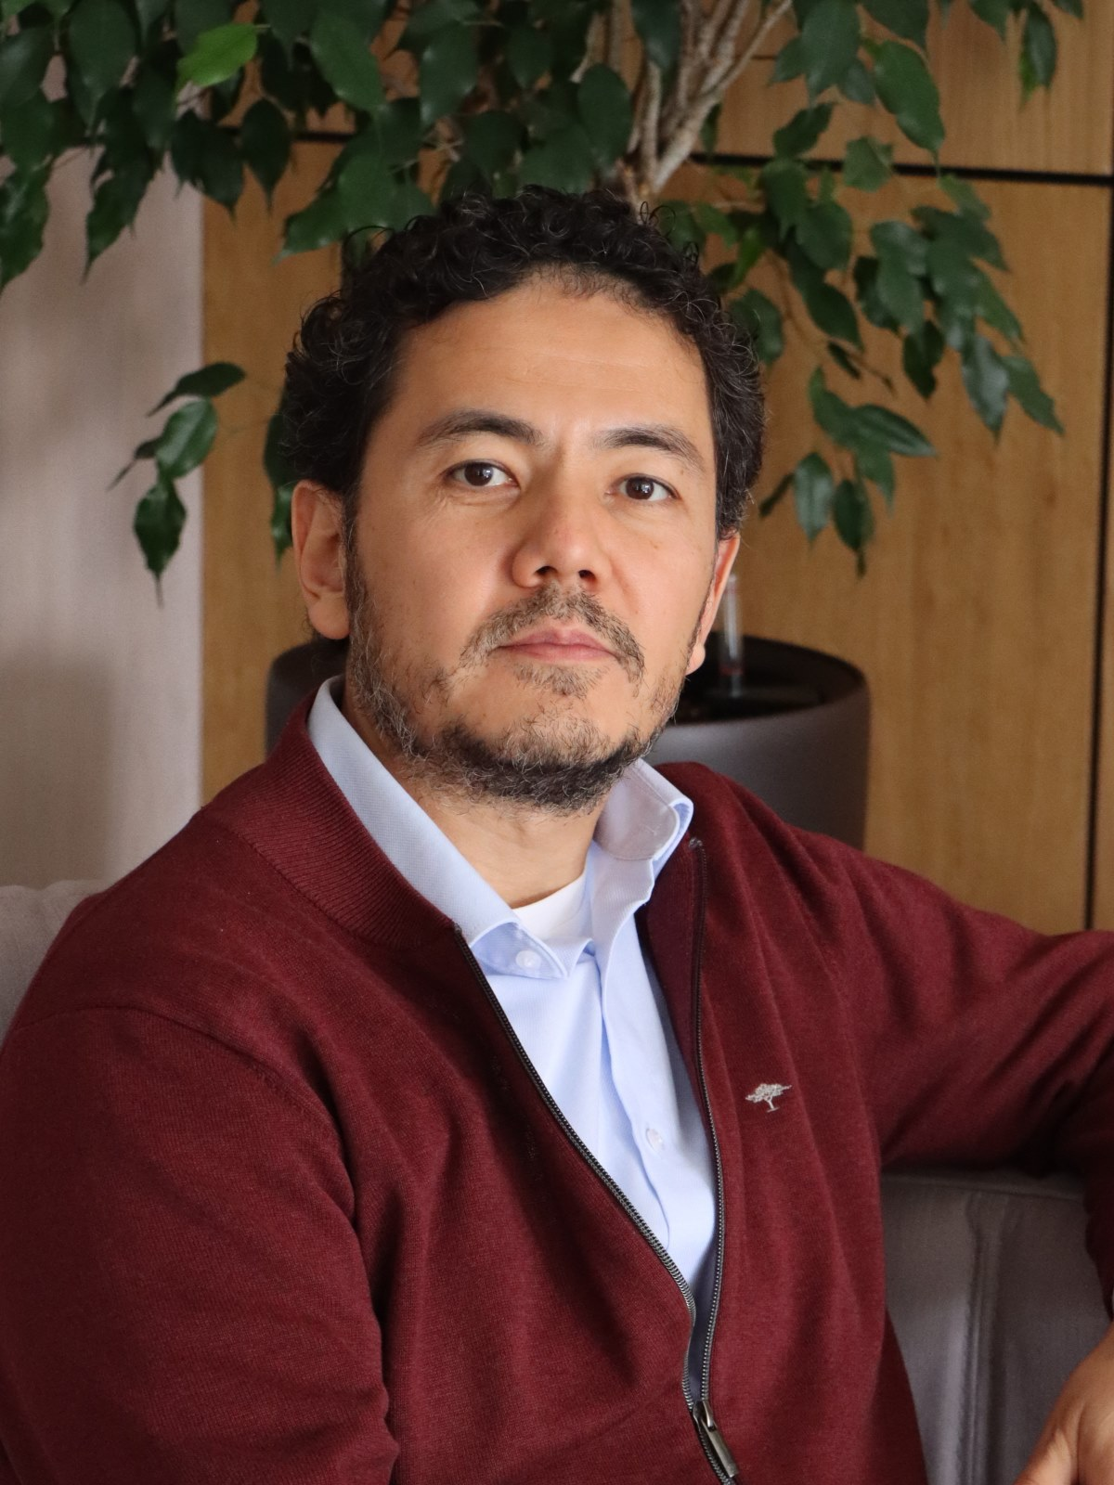
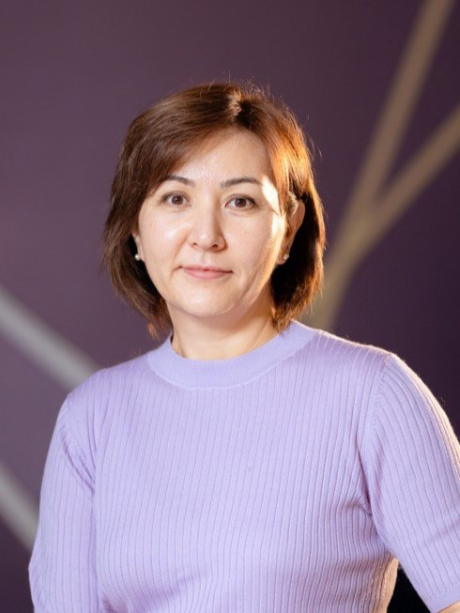
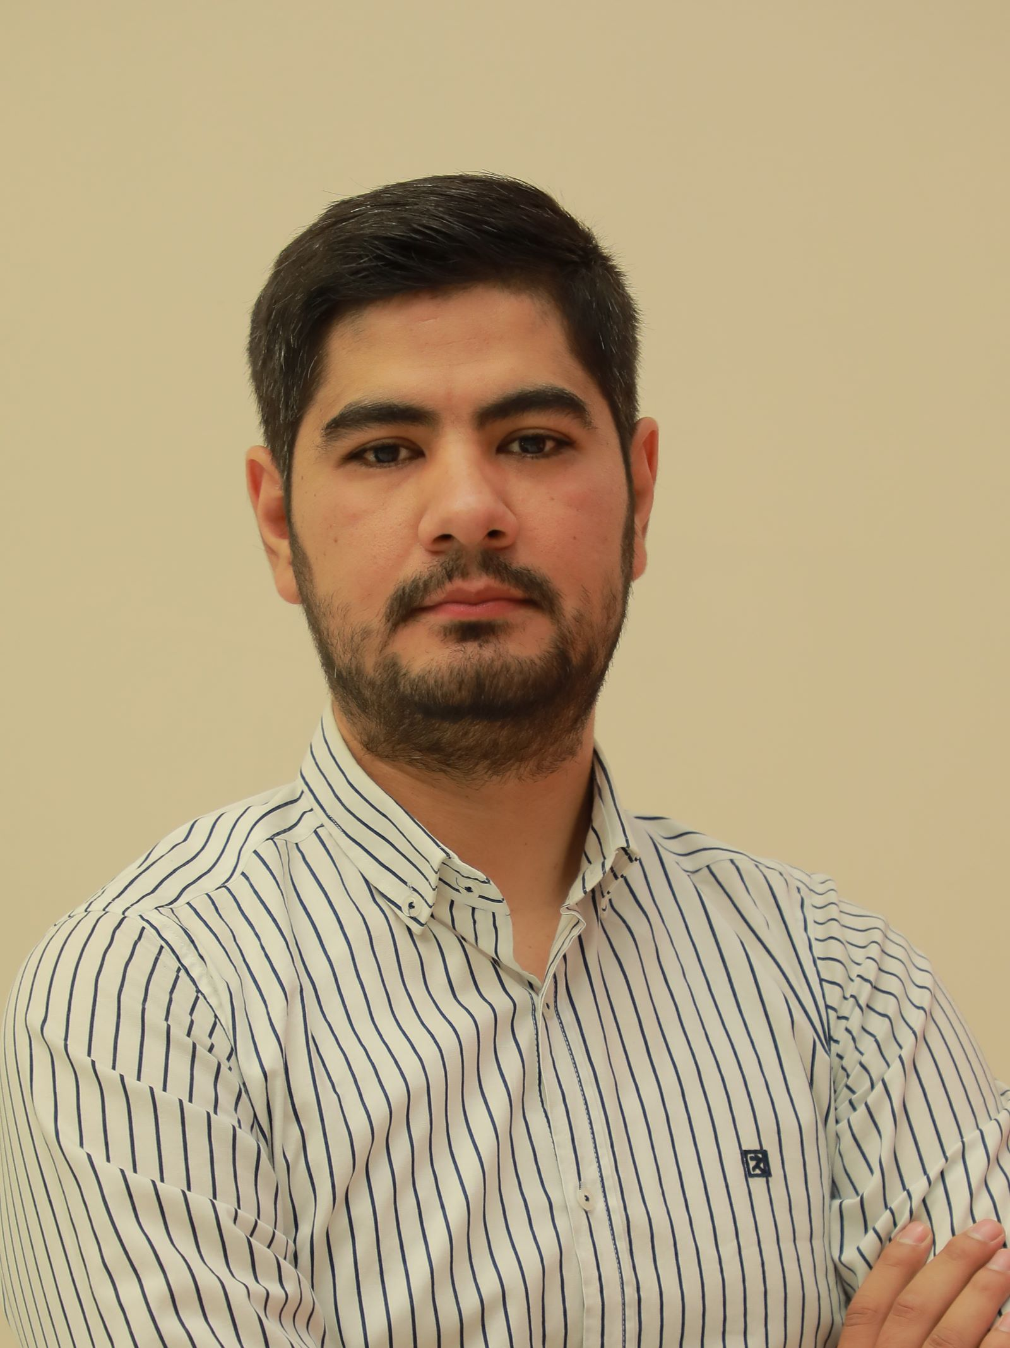
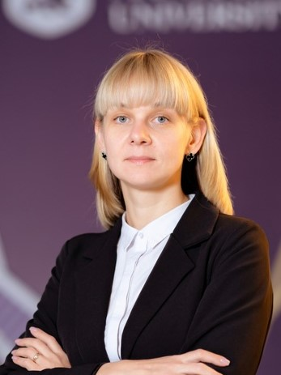
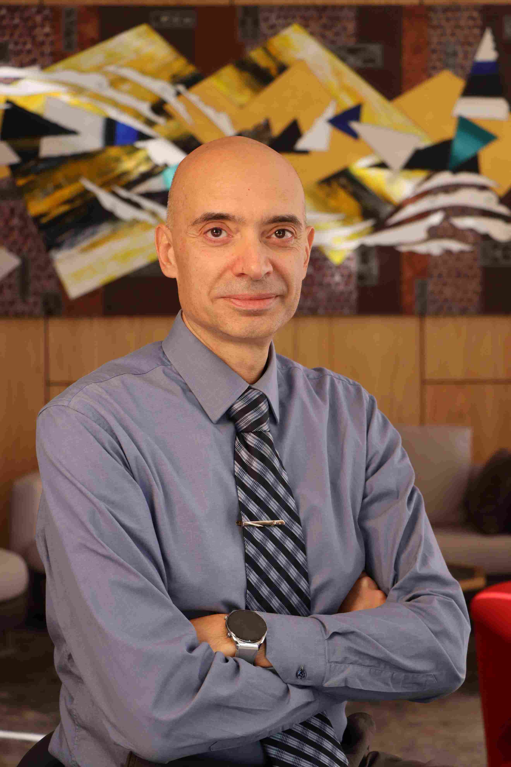
Academic Team – BBA with pathways
Alisher Khasanov - Vice Rector – Academic, Senior Lecturer in Business Strategy
Christian Capone, PMP ® - Senior Lecturer in Project Management
Elnora Mirzalieva - Senior Lecturer in Human Resource Management
Markhabo Nazarova –Lecturer in Business Law and Ethics
Azamat Nurmatov – Lecturer in Business and Management
Maria Markova – Lecturer in Marketing

Slide 53
Available Modules
Year 1 (Semester 1) | Year 2 (Semester 1)
Principles of Microeconomics | Corporate and Business Law
Introduction to Accounting | Business Communications
Introduction to Finance | Foundations of Project Management
Elective (General Education) | Entrepreneurship
Year 1 (Semester 2) | Year 2 (Semester 2)
Principles of Macroeconomics | Elective (from another pathway or from other degree programmes, see below)
Principles of Marketing | Global Business and Sustainability
Human Resource Management | Business Ethics and Professional Standards
Communication in Teams (PM) | Organisational Behaviour (PM)
Introduction to Communications and PR (DME and PR) | Principles of Supply Chain Management (LOG)
Introduction to Sustainability (LOG) | Communication Strategy (PR)
 | Digital Marketing (DME)
Notes:
Electives (Y1): Globalisation, English Literature, Introduction to Philosophy, Career and Personal Development, Introduction to Programming with Python.
Electives (Y2): Financial Accounting, Introduction to Financial Markets and Institutions, Data Analysis with Advanced Excel
Communication in Teams, Introduction to Communications and PR, Introduction to Sustainability

Slide 54
Available Modules
Year 3 (Semester 1) | Year 3 (Semester 2)
Cross-Cultural Leadership | Entrepreneurship at Scale
Elective (from another pathway or from other degree programmes) | Corporate Strategy
Advanced Project Management (PM) Logistics Solutions (LOG) Crisis Communication (PR) Managing an E-Business (DME) | Elective (from another pathway or from other degree programmes, see below)
Capstone Project (Business Consultancy Project or Dissertation) Year Long
Notes:
Electives (Y3): Data Visualization with Tableau Business Information Systems Management Accounting Principles of Supply Chain Management
Organisational Behaviour Communication Strategy Digital Marketing Environmental Economics Design Thinking

Slide 55
Dual Diploma

Slide 56

Programme Support
CAPM training and exam preparation (Certified Associate in Project Management)
Career support and industry links, including a career fair and internship openings
Field trips; past visits include Artel, GM Powertrain, and Hilton
Guest lectures by firms such as Uzcard and Ipak Yuli Bank
Structured help for students who join Сase competitions

Slide 57
Potential Careers (Uzbek market)
BBA with Project Management | BBA with Digital Marketing and E-business | BBA with Logistics and Supply Chain Management | BBA with PR and Communication
Project Assistant | Digital Marketing Specialist (SMM, Content Creator) | Logistics Specialist/Coordinator | PR Specialist / PR Manager
Project Coordinator | SEO/PPC Specialist | Procurement/Purchasing Manager | Communications Officer
Project Manager ( IT, construction, government, finance etc.) | Digital Marketing Analyst | Customs Specialist/Logistics Broker | Media Relations Manager
 | Digital Project Manager | Supply Chain Manager | Event Coordinator (PR events)
Around 1500 current vacancies in hh.uz | Around 1000 current vacancies in hh.uz | Around 500 current vacancies in hh.uz | Around 200 current vacancies in hh.uz
Starting: $ 500 - $700 Mid: $1000 - $1500 Senior: $2500 – $3500 +KPI | Starting: $300 - $450 Mid: $800-$1200 Senior: $2000 - $2500 Executives: $5000+ | Starting: $400-$500 Mid: $ 1000 Senior: $2000 - $3000 + KPI | Starting: $500 Mid: $ 900 - $1200 Senior: $ 1800 - $2000 + Recognition
Source: ishhaqi.uz / hh.uz

Slide 58
Top Industries Graduates Are Working In

Slide 60
Join to Our Success Stories
Video by Ekaterina (Class of 2024) – Founder of her own English School
Video by Akromkhuja (Class of 2024) – Project Manager at KPMG
Speech by Dildora, graduating student

Slide 61
Your Questions, Our Answers
Questions & Answers Session

Slide 62
Elective:
English Literature

Slide 63
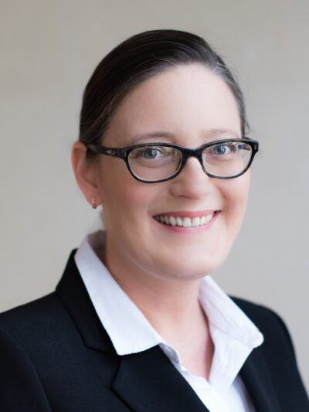
Module leader – English Literature
Katherine Rick
Master of Applied Linguistics (TESOL), Cambridge CELTA, Graduate Diploma in Tertiary Teaching & Learning
Senior Lecturer in English Language
k.rick@bmu-edu.uz

Slide 64
English Literature Module Objectives
The primary aim is to help students develop their reading proficiency by engaging a range of literary texts in order to decipher meaning and reflect on deeper themes through classroom discussions and essay prompts.
The secondary aim of this course is to generate students’ interest and appreciation of literature arts as a tool for personal and social transformation through written reflection.

Slide 65
Learning Outcomes
Interpret and analyse a range of literary texts (prose and poetry)
Cite from the text to support analysis in written responses
Participate in classroom discussion on the elements and themes of a text
Demonstrate written reflection of various texts and how they relate to the real-world.

Slide 66
Contact hours and Learning Materials
Seminars (18 hours)
Students will have in class reading sessions and discussion circles (18 hours)
Guided independent study (164 hours)
Main Texts
Eliot, T.S. (2001). The Waste Land (M. North, Ed.). WW Norton.
Shakespeare, W., Courteaux, W. (2017). Hamlet. Meulenhoff
Shelley, M. (2012). Frankenstein. Penguin Classics.
Wordsworth, W. (1807). I Wandered Lonely as a Cloud.

Slide 67
Assessments
Portfolio (80%) – a set of essays – answers to reflective and critical questions. Total word count: 1500 words.
Classroom participation (20%) – students will verbally demonstrate their understanding of the various texts by contributing to discussion circles: attentively listening to peer responses and further engaging with ideas.

Slide 68
5 Reasons to choose English Literature
Enhanced Communication Skills
English Literature sharpens your ability to write and speak persuasively, an essential skill in business for crafting compelling reports, presentations, and marketing content.
2. Critical Thinking Development
Analyzing complex texts fosters critical thinking, allowing you to evaluate business situations, identify key issues, and make strategic decisions more effectively.
3. Cultural Awareness and Empathy
Literature exposes you to diverse perspectives and human experiences, helping you better understand and connect with clients, customers, and colleagues from different backgrounds.

Slide 69
5 Reasons to choose English Literature
4. Creative Problem Solving
Literature encourages creative thinking and innovative approaches, which can be applied to developing unique solutions in business challenges.
5. Improved Emotional Intelligence
Studying characters, motivations, and relationships in literature enhances your emotional intelligence, crucial for leadership, team management, and customer relations in the business world.
Can you think of any more reasons? ☺

Slide 70
Student Feedback from 2024
“I really enjoyed your lectures! They were informative yet so fun!”
“I am very happy that I chose English literature as an elective module! I will never forget those incredible seminars full of joy.”
“I am so happy that I had this one short but wonderful semester with your amazing sessions.”
“Your lessons have helped me improve, and I’ll keep working hard to get even better.”
“I want to express appreciation for the experience and new knowledge which I gained from our classes. It was a wonderful time!”

Slide 71
Your Questions, Our Answers
Do you have any questions about English Literature?

Slide 72
Elective:
Career and Personal Development

Slide 73
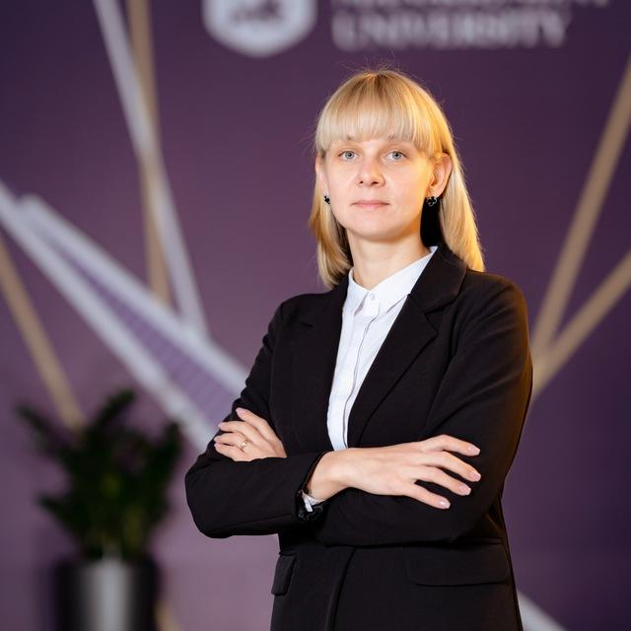
Module Leader
Mariia Markova m.markova@bmu-edu.uz
Mariia Markova is a highly experienced communications and event management professional with over 25 years in the field. She is known for her attention to detail, creative approach to public relations, and strong skills in media relations, social media, budgeting, and event planning. She also works as a business coach, helping others grow their professional skills.
Alongside her business career, Mariia has spent the past eight years teaching and publishing research, actively developing her academic profile. She holds degrees in natural sciences and psychology/pedagogy, as well as an MBA in Marketing from the Berlin School of Business and Innovation. Currently, she is pursuing a PhD at the Faculty of Business Administration and Economics at Eastern Mediterranean University in Cyprus.

Slide 74

Programme Objectives
Develop an understanding of your personal strengths, values, and career interests
Adopt actions that reflect a positive outlook about self and successively contribute positively to relationships throughout one’s life and work.
Recognize how changes that develop in the physical, psychological, social and emotional development of an individual impact both their present and future life and work.
Recognize how an individual’s overall flexibility and adaptability to cope with change directly impacts on workplace satisfaction and productivity.
Examine the relationship among personal skills, personal achievements, academic performance, and attitudes and their influence on life and work-related choices and successes.
Create a personal career plan that aligns with their personal goals and aspirations.

Slide 75
Assessment components
Mid-term assessment
Group Video
Final assessment
Personal career plan

Slide 76
Reasons to join
Suitable for absolutely everyone - no routine, just drive and fun
All theory is immediately applied in practice - the results will not be long in coming
The opportunity to understand your strengths and weaknesses and learn to use them in your career and life
The teacher is a practicing business coach who has successfully employed at least 150 people

Slide 77
Your Questions, Our Answers
Don’t wait - create!

Slide 78
Elective:
Globalisation

Slide 79
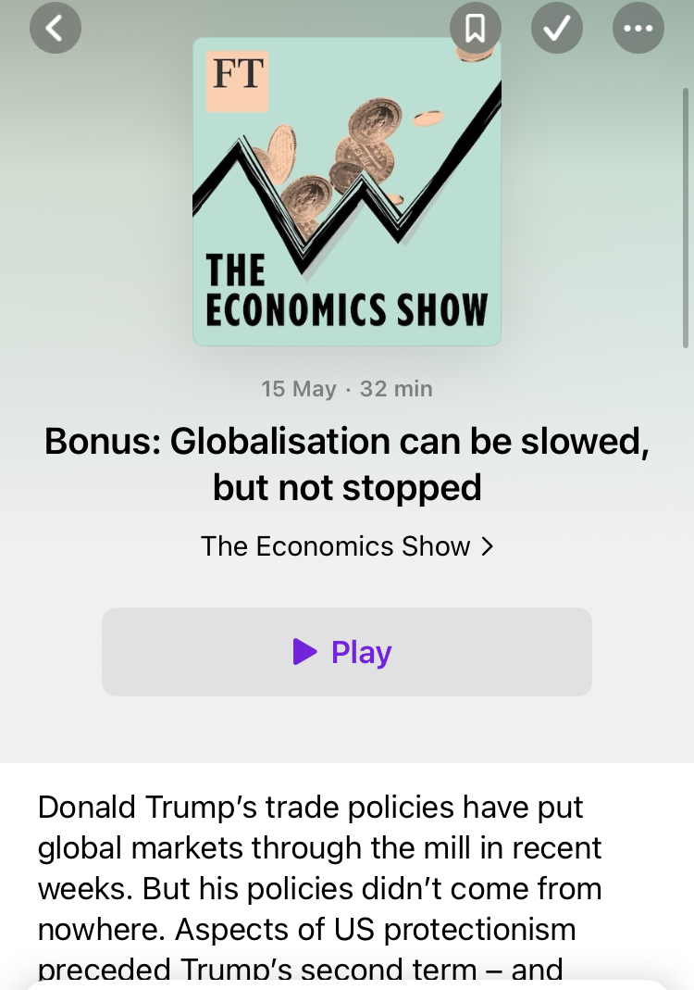
Globalisation

Slide 80
Themes
Development of Globalization
Economy and Trade
International Institutions

Slide 81
Trends
Communications and Technology
Culture, Language, and Religion
Migration and Travel

Slide 82

Themes
Climate and Environment
Economic Development and Poverty
Human Rights

Slide 83

Future of Globalisation
Political reactions
The end of Globalization?

Slide 84
Elective:
Introduction to Programming with Python

Slide 85

Introduction to Programming with Python
“From logic to loops, from lists to games – start your coding journey here.”

Slide 86

Introduction to Programming with Python
Module Code: ICT201
Instructor: Prof. Timur Umarov, Ph.D. Computer Science
Office Hours: Wednesdays, 15:00–17:00
Credits: 20 | Level: SCQF 7 | Semester: Autumn
This course teaches core programming principles through Python, one of the world’s most popular languages for data, automation, and software development.
“From zero to Pythonista – one line of code at a time.”

Slide 87
What You'll Learn
By the end of this module, you’ll be able to:
  Understand core programming concepts and Python’s key features
  Write, debug, and run Python code using functions, data structures, and file I/O
  Apply loops, conditionals, and modular design to solve real problems
  Build your first end-to-end Python programs with interactive logic and persistent storage
  Present and reflect on your coding work through portfolio tasks
“Learn to think like a developer. Build like a pro.”

Slide 88
Topics We’ll Explore
Weeks 1-4: Getting Started
  Topics: Programming basics, syntax, variables, flowcharts
  Mini Project: “Python Fortune Teller”
  → Randomized text output, basic input, string handling
Weeks 5-8: Logic and Control
  Topics: Conditionals, loops, functions, number games
  Mini Project: “Number Guessing Game”
  → While-loops, conditionals, random module
  Challenge: “Prime or Not?”
  → Math logic + user input
“Each block ends with a mini-game. Learn by building something fun and useful.”

Slide 89
Topics We’ll Explore
Weeks 9-12: Data Structures + Files
  Topics: Lists, dictionaries, strings, sets, files
  Mini Project: “Quiz Game with Score Tracker”
  → File I/O, dictionaries, scoring
  Challenge: “Hangman Game”
  → Sets, loops, string operations
  Bonus Game: “Tic-Tac-Toe (X-O Game)”
  → 2D lists, nested loops, game board logic, win conditions
“Code is more fun when it plays back!”

